Slide 1
CLoSES-SEM
General Overview

Slide 2
Overview
This presentation aims to provide an overview of the CLoSES-SEM platform
It is designed to detect and send stimulation during cognitive tasks.
It uses encoder/decoder model to estimate hidden cognitive state.
Usually detection occurs during a trial and stimulation at the start of the following trial.

Slide 3
Types of Models
CLoSES-RT: Closed Loop to Physiology
Human Real Time (data from BlackRock NSP)
NHP Real Time (data from Plexon)
Simulations
CLoSES-SEM: Trial by Trial Neural Decoder Model
Human Real Time (data from BlackRock NSP)
Simulations
Notes:
One PPT for each of these models will explain them in more detail
Each group use the same closed-loop model diagram. The only difference is the input.

Slide 4
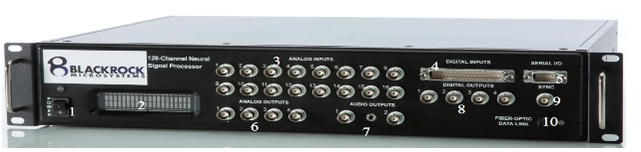
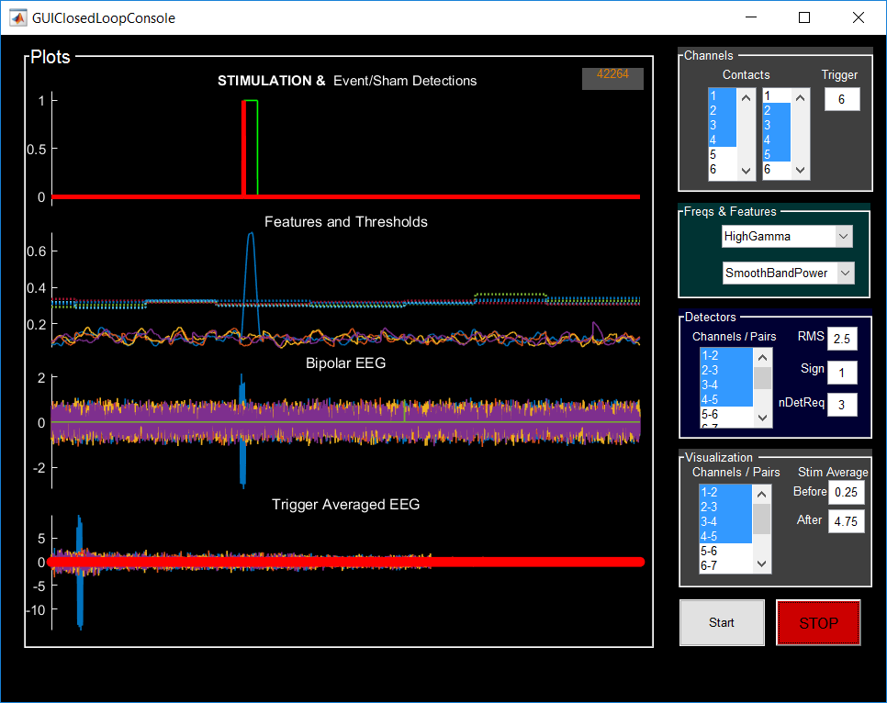
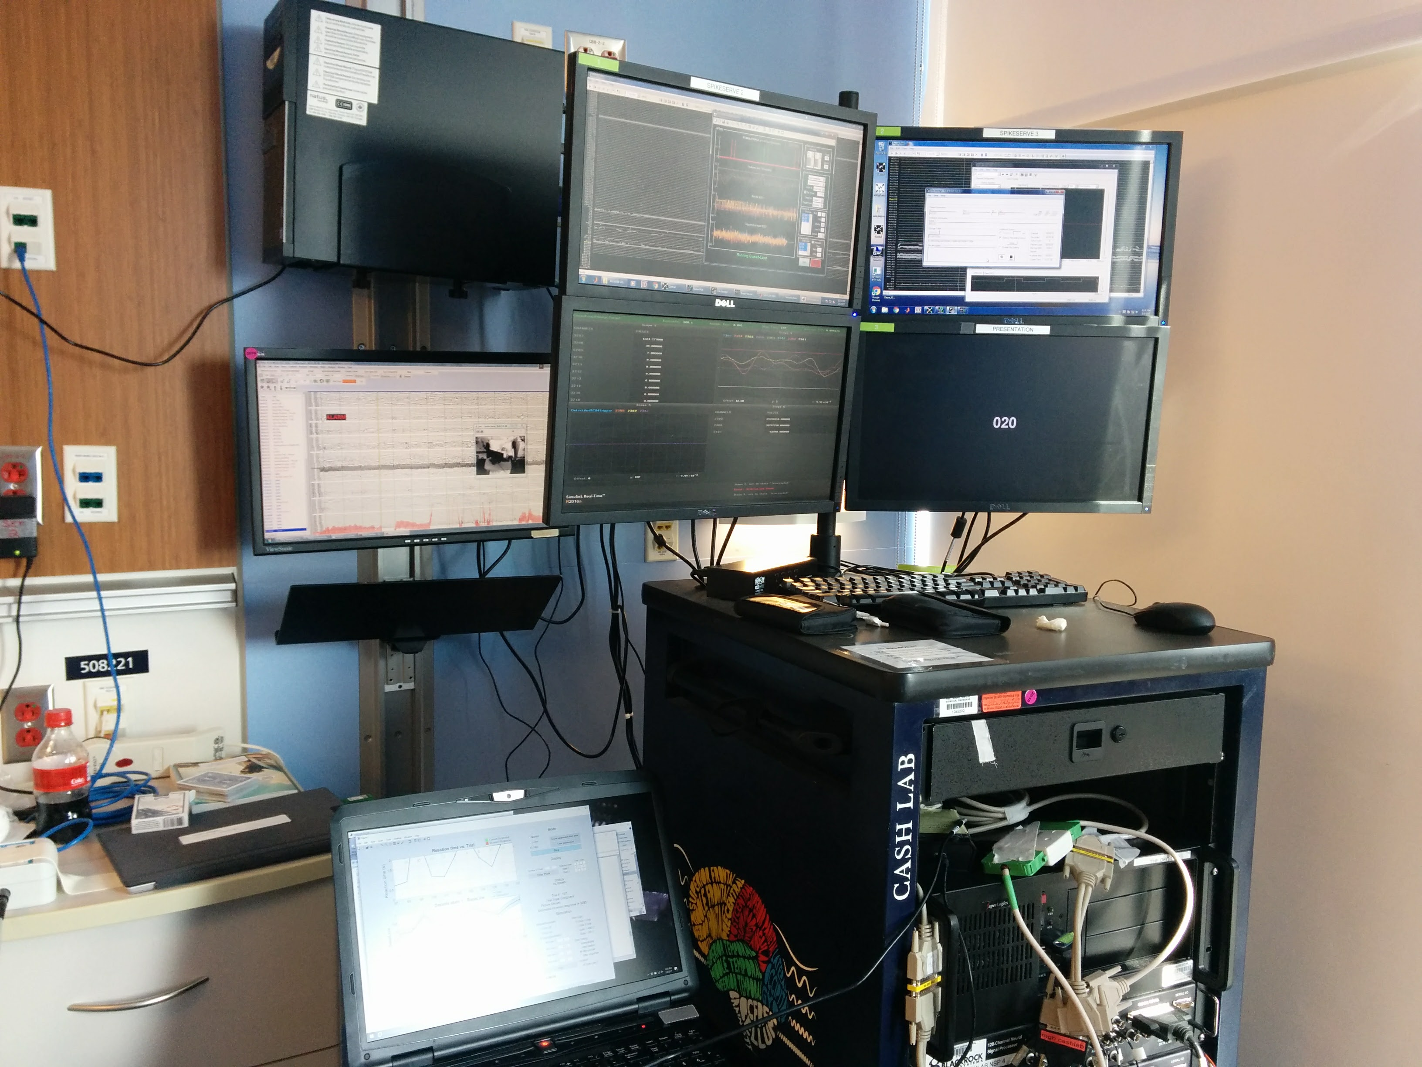
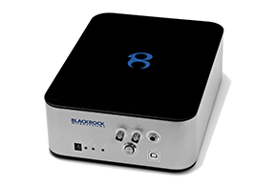
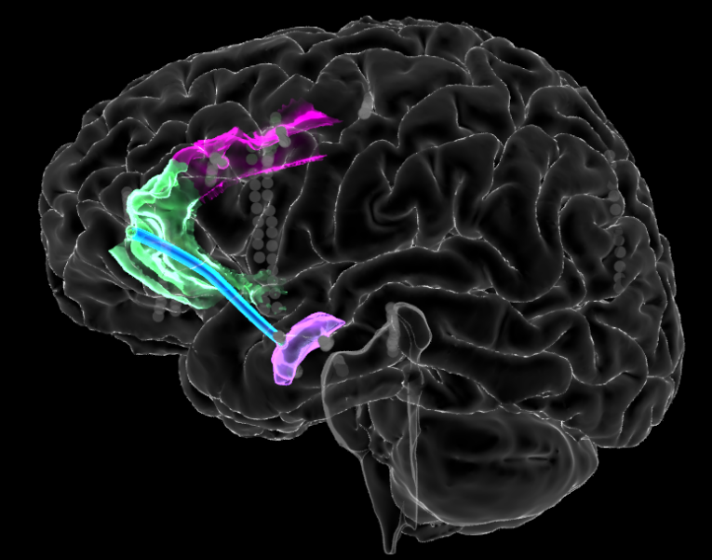
Closed-Loop Hardware Strategy
Neural Acquisition
Closed-loop Physiology
Neuronal Data
GUI (host)
Decider (target)
Stimulate
Patient
dACC stimulation
Tasks
020
rACC-Amygdala
theta band coherence,
Schematic of closed-loop experiments using rack-mounted hardware.
Notes:
This is the experimental setup: multiple independent boxes/rigs coupled together through a set of one-off interfaces.
The key point is that the same stimulator, coupled to the same electrodes in the patient, can be controlled
directly by the task (stimulation linked to presentation of task cues and responses),
by a real-time estimation of our hidden state variables, or
by real-time estimation of a neurophysiologic variable.
Today we’re showing you (1) and (3).

Slide 5
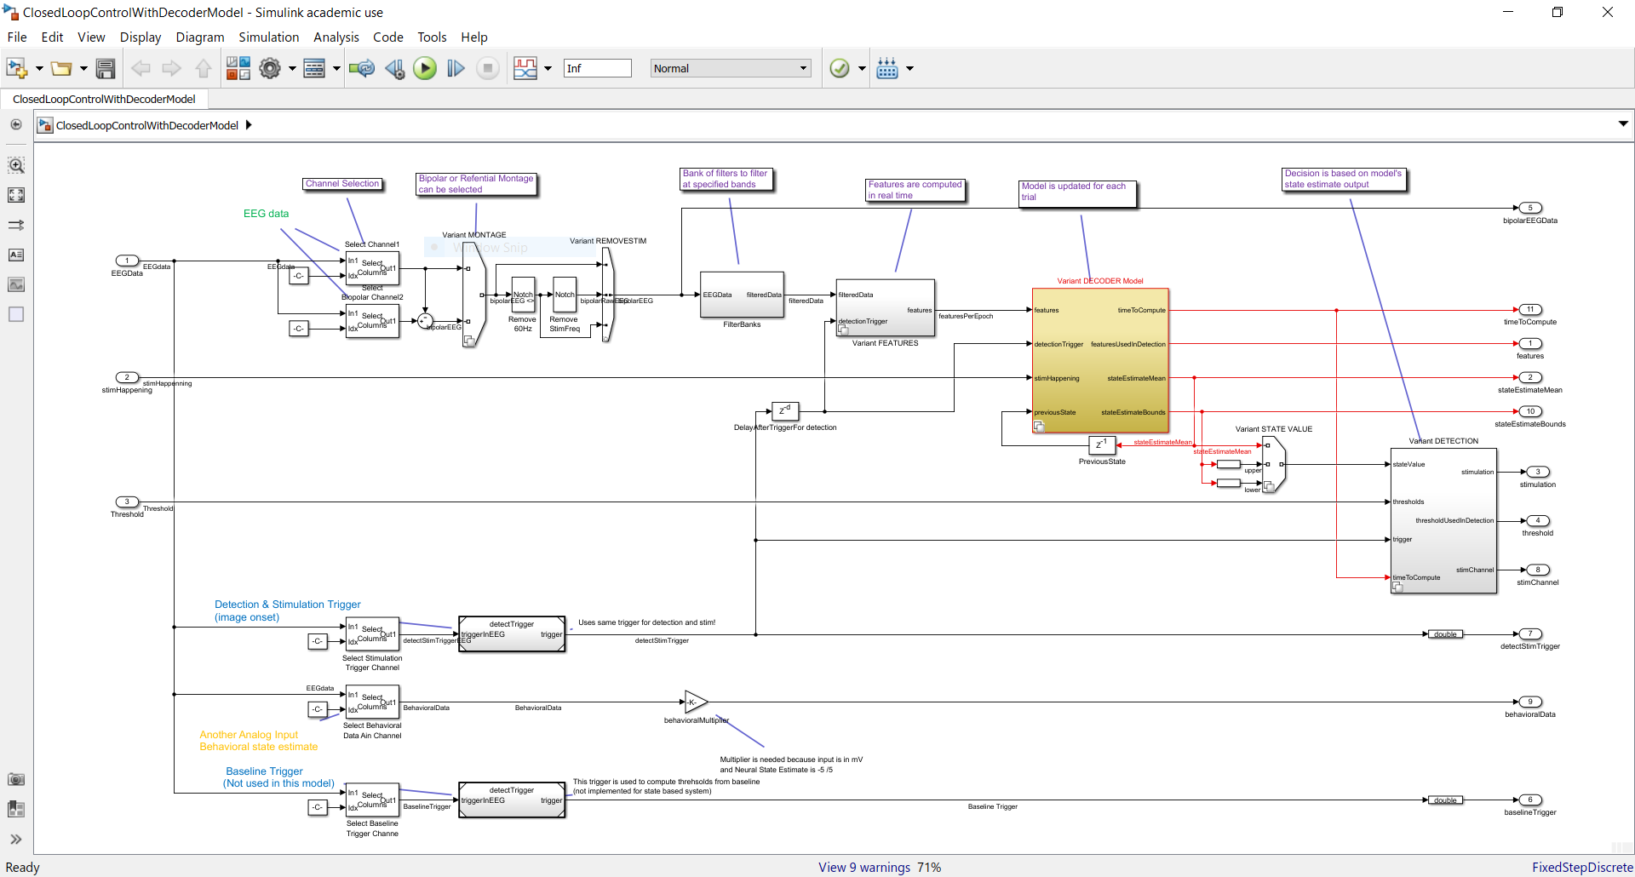
CLoSES-SEM Diagram

Slide 6
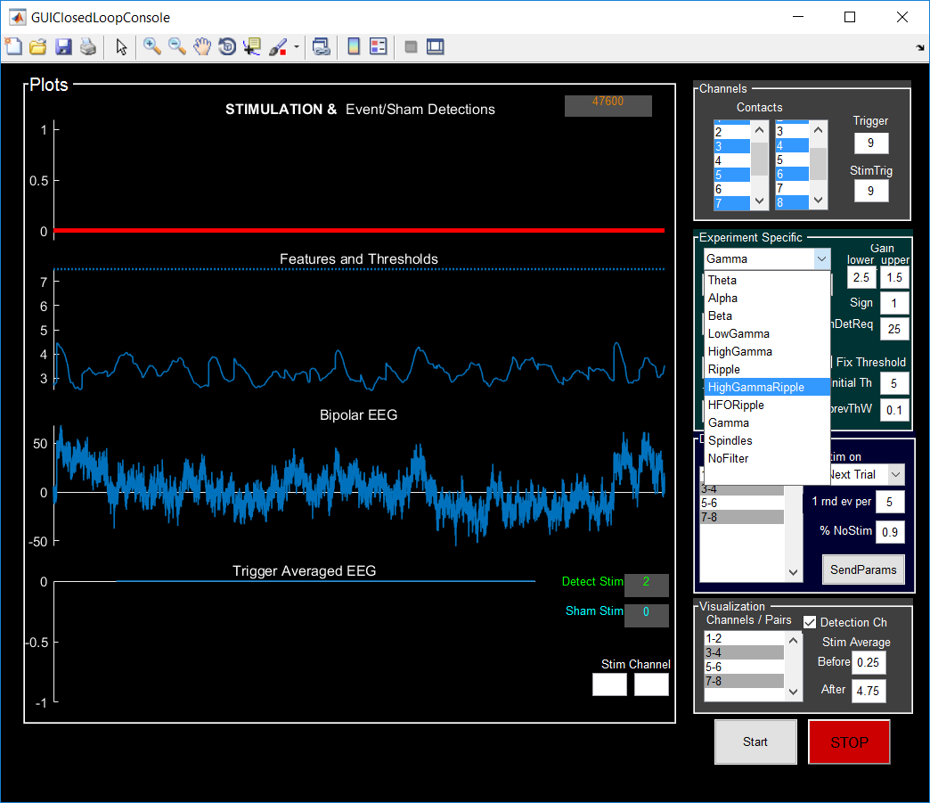
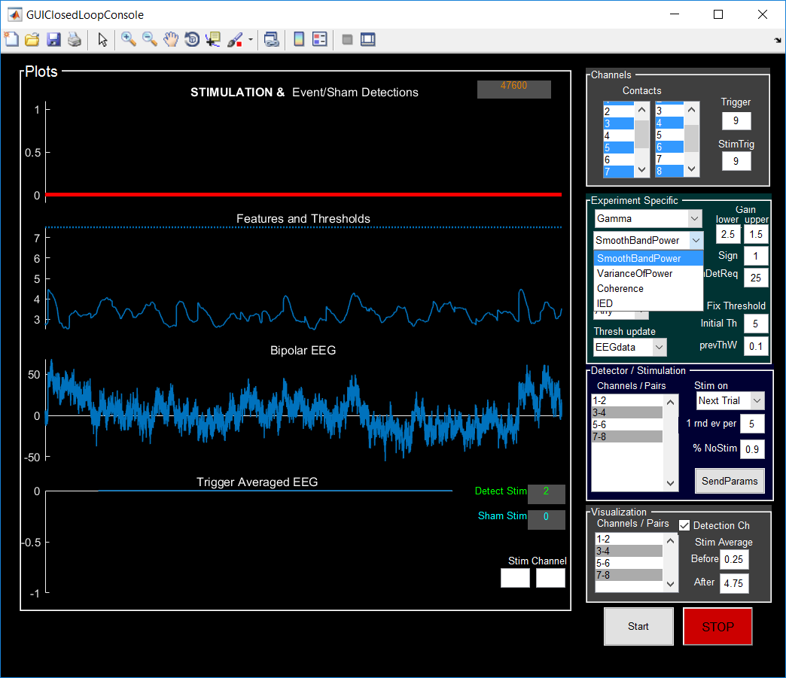
Decoding/Detection Methods
Provide stimulation if feature at a particular frequency band is above (below) threshold for a specified duration.
Implemented features:
Power and coherence
Various frequency bands.
Examples:
ECR / Movies: Theta coherence
MSIT: HighGammaRipple smooth power
Spikes : no-filter smooth power
Sleep: Alpha (or spindles) smooth power
Frequency Bands
Features

Slide 7
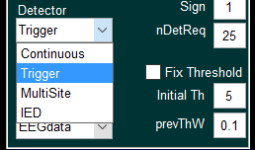
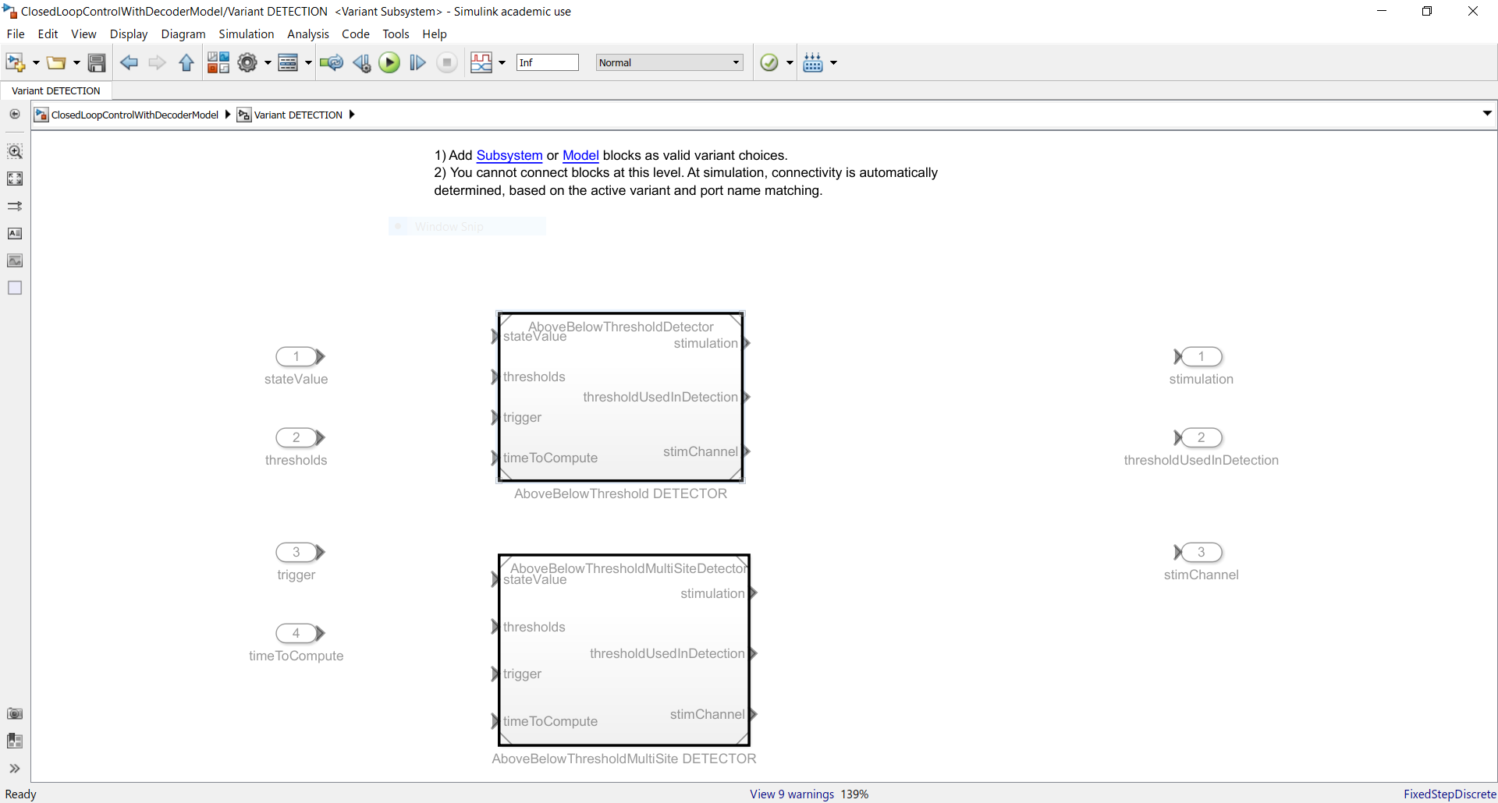
Detection Methods: Detectors
Detector Type

Slide 8
Stimulation
Stimulation could be sent
in real time,
at a trigger (e.g. next trial).
with fix delay (for both)
Stimulation output is a TTL pulse
It is also possible to modify Cerestim configuration (e.g. for MultiSite) but this occurs on the host.
Additional outputs on parallel port:
Channels to Stim (in case of Multi-Site)

Slide 9
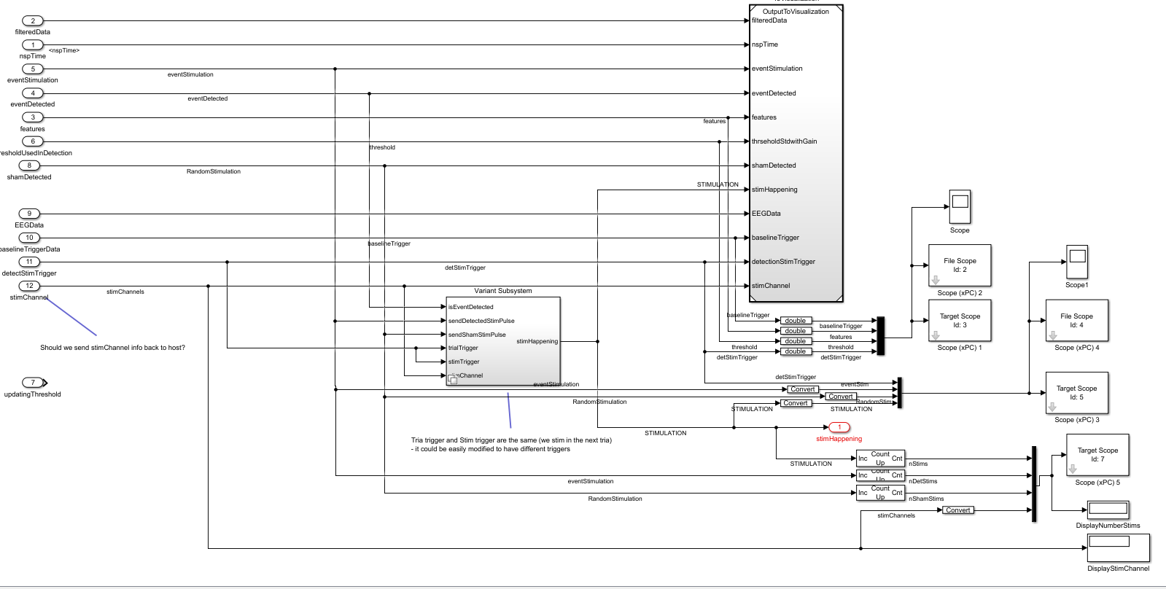
Outputs
To host
(GUI)
Output to Stimulator (TTL)
In decider computer

Slide 10
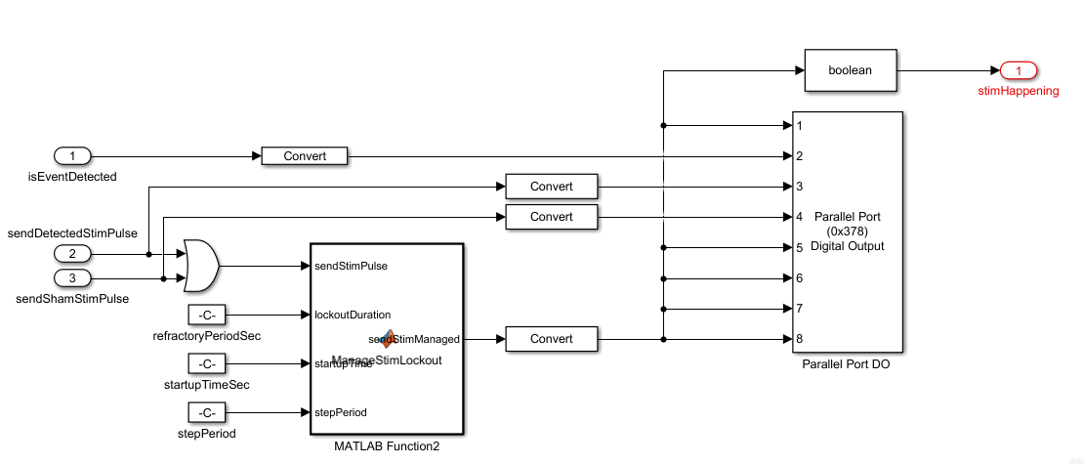
Output to Stimulator (TTL)

Slide 11
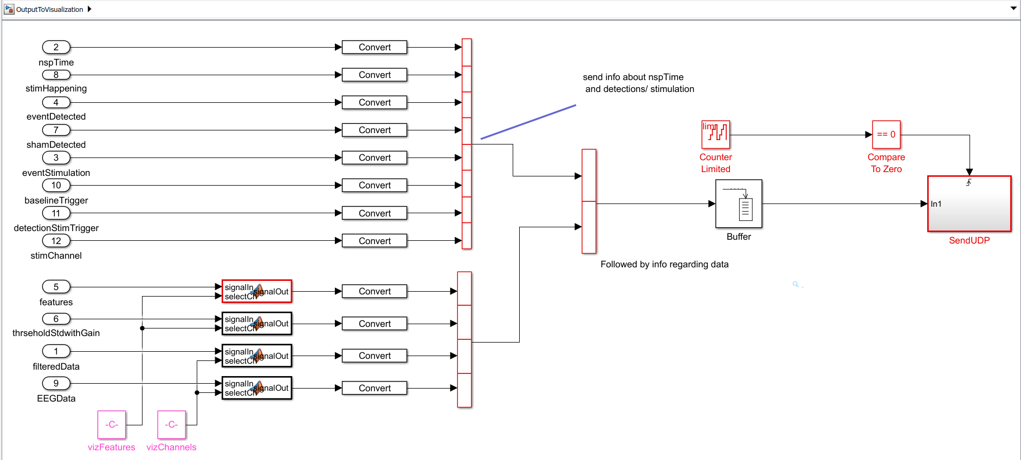
Output to Visualization
Visualization information is sent through UDP (crossover cable)
to host computer (e.g. spikewave 2)

Slide 12
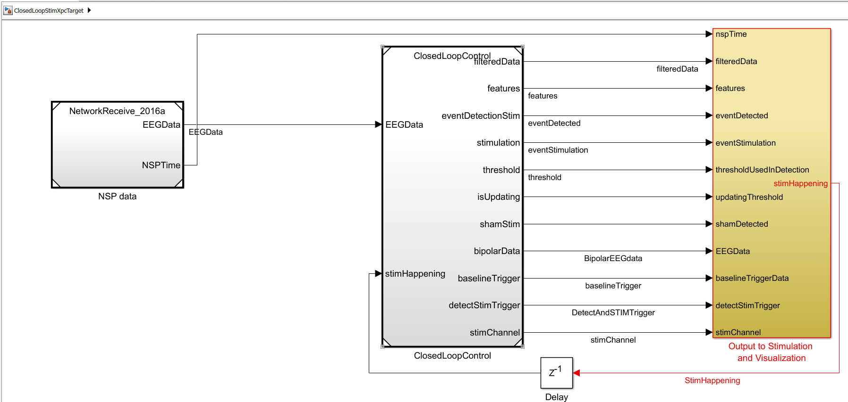
Models for different Inputs
ClosedLoopStimXpcTarget: Input from BlackRock through UDP
(Ethernet network connection)

Slide 13
ClosedLoopStimXpcTarget
Input from NSP1 corresponds to contacts: 1-200
Input from NSP2 corresponds to contacts: 201-400
Triggers:
Ainp1 (sync) = 129
Ainp2 (trigToStim) = 130
Ainp3 (ImageOnset) = 131

Slide 14
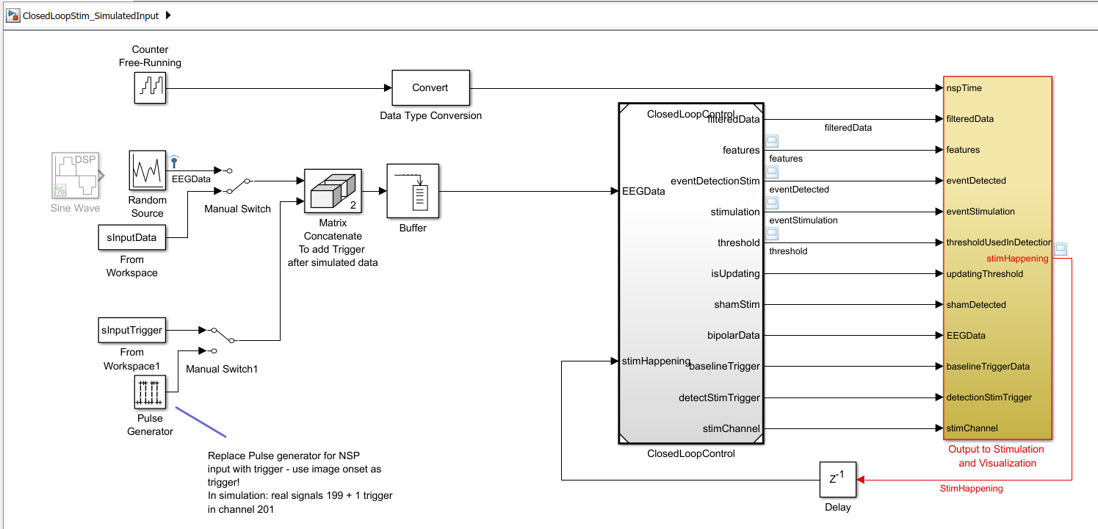
Models for different Inputs: Simulations
ClosedLoopStim_SimulatedInput: everything runs on your computer.
Possible inputs: random noise or Matlab variable

Slide 15
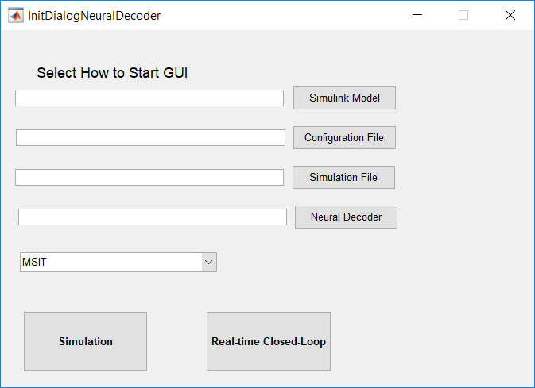
How to run CLoSES-SEM with GUI
Turn on CLoSES target computer (“CLoSES” USB should be connected)
In MATLBA 2016b type: GUINeuralDecoderClosedLoopConsole ('PatientName',NAME)
On Initialization screen select config file, neural model, and type of experiment
Example for MSIT Closed-Loop

Slide 16
Simulation input
Possible inputs:
Random noise + sine
Matlab variable (MAT file)
Scripts to generate MAT (in folder SimulationsCode):
script_createSimDataFromRealData.m
script_createSimDataFromNEVfile.m
script_createSimDataFromPlexonFiles.m
See also: stepByStepCreateSimulatedDataSet.m

Slide 17
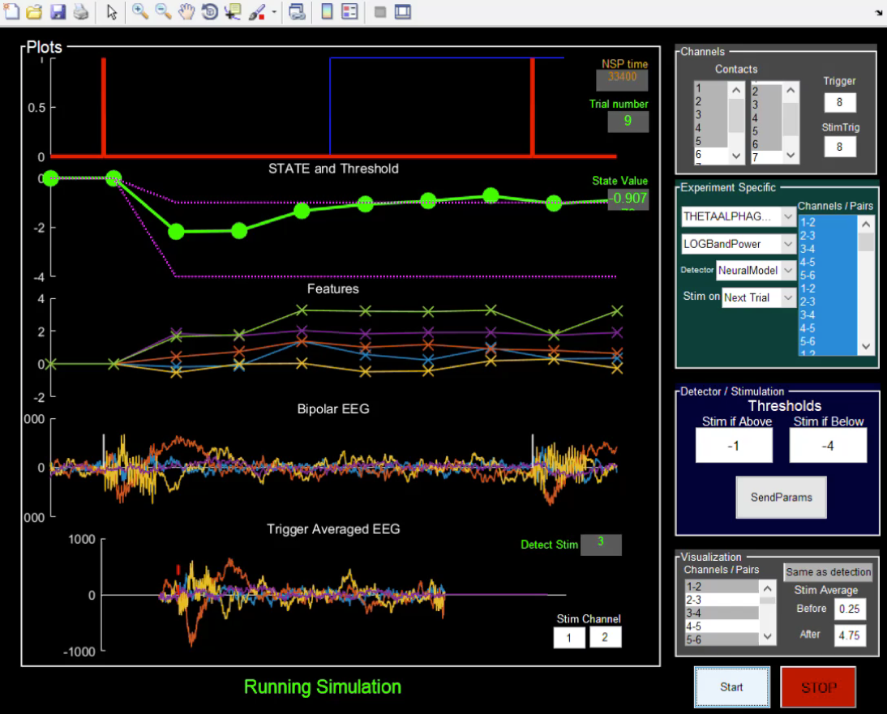
GUI
Example of simulated data generated from patient running MSIT
Notes:
Example of simulated data generated from patient running MSIT
Details:
- Contacts are selected to create bipolar channels
- Stimulation happens on following trial
- Detection happens if ANY feature is > Threshold
- Threshold is updated in each trial based on signal 0.5sec before trigger (Trigger: EEGData)

Slide 18
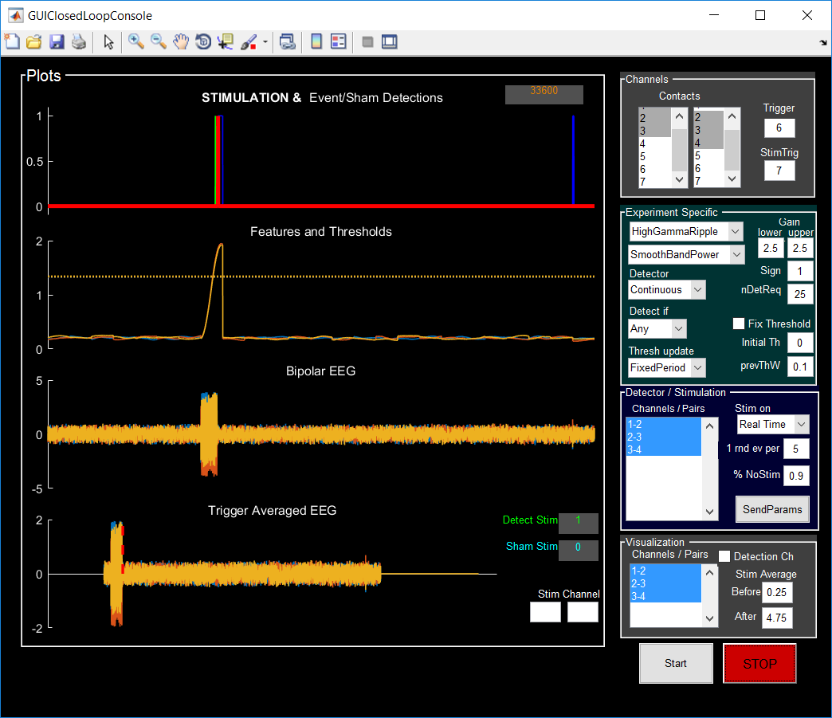
GUI
Example of simulated using sine+random
Notes:
Quick video capture on how to use it

Slide 19
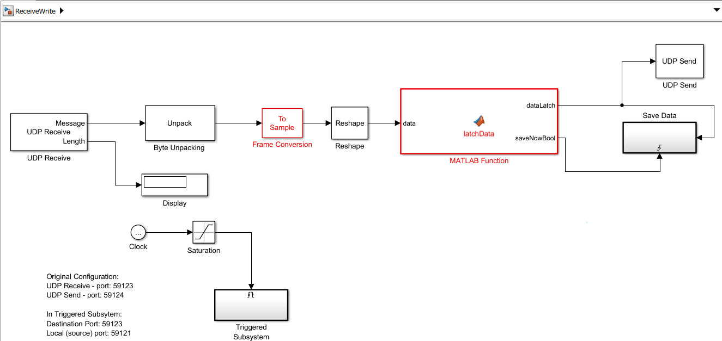
Model to Visualize and Save data
To GUI
From Decider
Save Data
This Runs on host computer
(where GUI is)

Slide 20
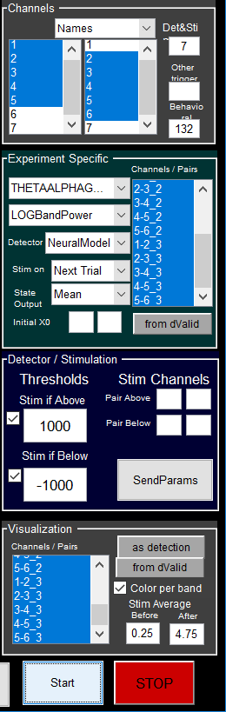
GUI Parameters
Contacts: left column is first contact of bipolar channel. Right column is second contact of bipolar channel.
Bipolar channel = # left col - # right col
NOTE: NSP2 contacts are 201 and above
Trigger: contact # of baseline trigger
Image onset for real time (default 131 – ainp3);
one before last for simulation
StimTrig: contact # of stimulation/detection trigger
usually same as Baseline Trigger

Slide 21
GUI parameters
Detect if state > (<) Upper (Lower) Threshold
Thresholds:
Upper: Stimulate if state output is above this value.
Lower: Stimulate if state output is below this value.
State output :
Mean
Upper/Lower bound
Initial X0: initial mean / std for decoder model
Channels/Pairs to use as input to decoder model can be:
manually selected
Selected from dValid (features used as input in the model)
All selected
Notes:
Information on various parameters – what they mean what values make sense

Slide 22
GUI parameters
Visualization
Channels / Pairs:
Select which channels or pairs to visualize.
Same as detection: if clicked, channels/pairs take the values of the detection channels/pairs.
From dValid all inputs of decoder model
Stim Average:
Before: time before stimulation in averaged plot (in second)
After: time after stimulation in averaged plot (in second). Before + after is always < 5sec
Notes:
Information on various parameters – what they mean what values make sense

Slide 23
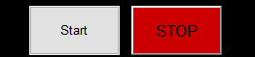
Configuration Parameters - GUI parameters
Starts: starts model.
If in rig the first time or each time a combo is changed (filters, features, etc) it will compile (takes about 1 minute).
Stop: when stop is clicked data is saved in dirResults directory (default C:\Temp).
File format: SessionData_PATIENTNAME_DATE_TIME.mat
Notes:
Information on various parameters – what they mean what values make sense

Slide 24
Configuration Parameters - Other parameters
Only the most common parameters can be modified on the GUI. Other parameters can be configured on Configuration files.
For detailed information of each parameter look at the different config files or at InitCoreParams.m in folder Parameters
Notes:
Information on various parameters – what they mean what values make sense

